Slide 1
Week 11: jQuery

Slide 2
Agenda
Questions?
Is jQuery Dying?
Should I Use jQuery?
The Toolbox
Vanilla vs jQuery
jQuery Advantages
Additional Resources
Next Week: Project

Slide 3
What questions do you have?

Slide 4
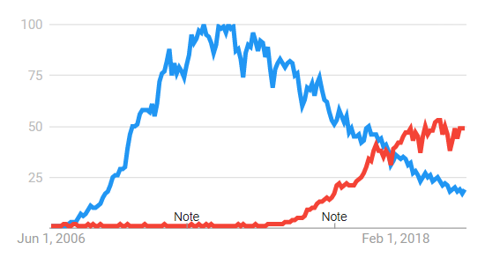
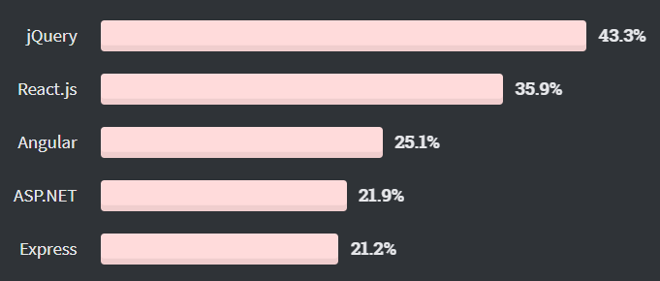
Is jQuery Dying?
Kind of.
These days there is very little that jQuery does that vanilla Javascript can’t do almost as easily.
But jQuery at one point was nearly synonymous with Javascript and that popularity takes a long time to fade. There will likely be projects and companies still using jQuery for a long time. But, Bootstrap 5 no longer includes jQuery which is probably the beginning of the end for jQuery.
Some new developers are not learning jQuery, it is starting to be considered a legacy skill.

Slide 5
Should I Use jQuery?
DOM Manipulation
Animation
AJAX
Use It | Don’t Use It
Simplifies DOM manipulation while being unopinionated | Vanilla is only slightly more complex and frameworks make low-level DOM manipulation unnecessary
Use It | Don’t Use It
Solid tools for moderately complex animation | CSS animation is faster and there are other libraries
If you are using React you should NOT use jQuery
Use It | Don’t Use It
Streamlined AJAX with polyfilled browser support | You can use fetch() or a more robust AJAX library like Axios

Slide 6
The Toolbox
Finding
const $elem = $(“query”)
const $parent = $elem.parent()
Reading & Updating
const oldValue = $elem.val()
$elem.val(“new value”)
Creating
const $newLink = $(“<a></a>”)
const $copiedLink = $newLink.clone()
Moving
$parent.append($newNode)
$sibling.before($newNode)
Deleting
$toRemove.remove()
$toEmpty.empty()
Listening
$button.click(myFunction)
$button.on(“click”, myFunction)

Slide 7
Vanilla vs jQuery
Vanilla Javascript
jQuery
const node = document.querySelector(“query”)
node.remove()
node.appendChild(anotherNode)
node.classList.add(“new-class”)
node.value = “new value”
node.textContent = “new text”
fetch(“http://www.u.com”).then(data => {
console.log(data)
})
const $node = $(“query”)
$node.remove()
$node.append($anotherNode)
$node.addClass(“new-class”)
$node.val(“new value”)
$node.text(“new text”)
$.get(“https://www.u.com”, data => {
console.log(data) })

Slide 8
jQuery Advantages
Cross-Browser Support | Nice, but cross-browser support is less and less of a problem these days Also that means it can be a little bloated with polyfills you don’t need
Chainability | jQuery is often shorter and it’s designed to be chainable: $(“.class”).parent().text(“blah”).addClass(“something”) document.querySelector(“.class”).parentNode.textContent = “blah”
Popularity | If you load it in through a CDN, chances are the user won’t even need to load it because another website will have already loaded it Using popular technologies makes it easier for you and others to maintain that code
Extra Tools | More options for how to find and manipulate the DOM. Things like: .appendTo() .wrap() .empty() .closest() .filter()

Slide 9
General Flow of a Web App
user clicks/types/etc
Render the page based on the data
Update the data

Slide 10
General Flow of a Web App
user clicks the add todo button
Add a todo to the array
Render the todos based on the array
Delete a todo from the array
user clicks the delete todo button

Slide 11
Additional
Resources
Free Code Camp jQuery vs Vanilla Javascript
https://www.youtube.com/watch?v=X65s7WQLWJY
Stack Overflow 2021 Developer Survey
https://insights.stackoverflow.com/survey/2021
State of Frontend
https://tsh.io/frontend-development-trends-2020/
jQuery API
https://api.jquery.com/
Can I Use
https://caniuse.com/
UK Government Site Removing jQuery
https://insidegovuk.blog.gov.uk/2022/08/11/how-and-why-we-removed-jquery-from-gov-uk/

